Slide 1
IPsolution
2025

Slide 2
Introduction
We deliver high quality services in upstream sector of oil and gas industry. Our mission is to minimize costs of exploration and production by deploying best experts and consultants.
Upstream section mainly focuses on reservoir studies with the aim of optimized recovery. All parts of geosciences and engineering studies including geophysics, geology, reservoir engineering, drilling and well engineering are integrated to deliver the most reliable results to clients. Applied training courses and consultancy services in related subjects are performed by experienced experts of our company.

Slide 3
Upstream section
Geophysics
Geology
Petrophysics
Reservoir
Drilling
Software
Skills and Software Knowledge

Slide 4
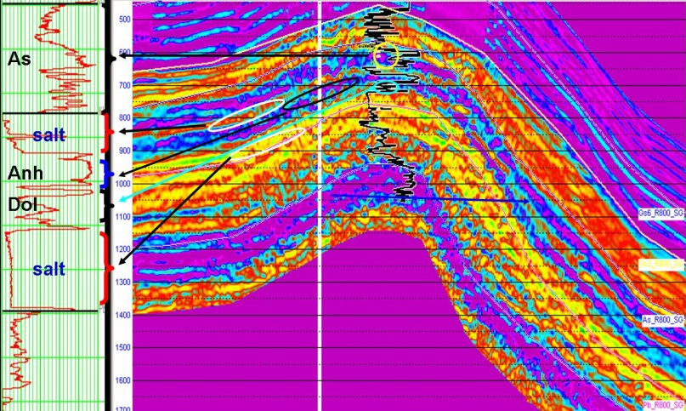
Geophysics
Seismic Survey Design
Conventional
Model-based
Seismic Data Interpretation
Well to seismic tie
2D and 3D seismic data interpretation
Velocity modeling and depth conversion
Seismic attributes analysis
4D seismic feasibility study

Slide 5
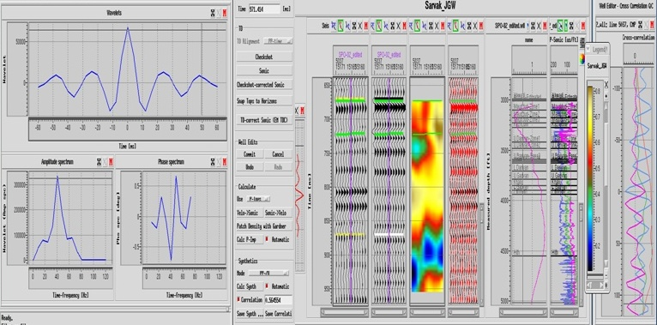
Geophysics
Reservoir Geophysics Studies
Stochastic and deterministic seismic data inversion
Prestack seismic data inversion
AVO studies
Seismic facies analysis
Pore pressure prediction and water saturation modeling
Reservoir geomechanics analysis

Slide 6
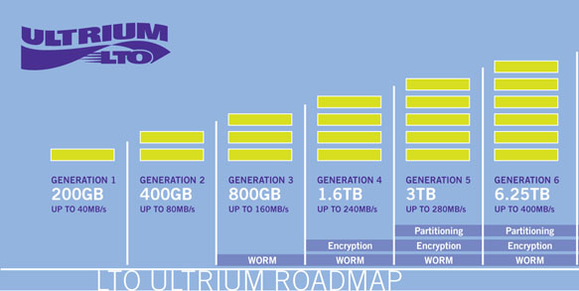
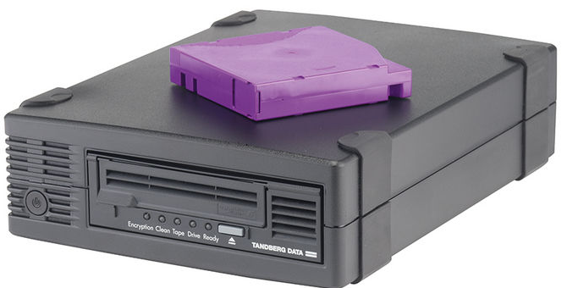
Geophysics
VSP Services
Operation Supervision
VSP Data Processing
Seismic Data Management
Supporting 3490/3590-DLT-SDLT-LTO3/LTO4/LTO5/LTO6

Slide 7
Geology
Stratigraphy and Paleontology
Field studies and field mapping
Outcrop measurement and preparing the lithological log, description and sampling
Thin section preparation from cutting, core and field sample
Palynological slides Preparation
Washed sample preparation and picking
Core analysis
Micro paleontological studies in order to age determination and biozonation
Preparation of microfossil stratigraphic distribution chart and preparation of Paleolog
Preparation of microfossil plates and paleontological report
Top Formation determination based on lithology, electrical log and biozonation
Preparation of Correlation Chart
Sedimentological and petrography studies
Preparing of petrography and sedimentology report
Sequence stratigraphy studies

Slide 8
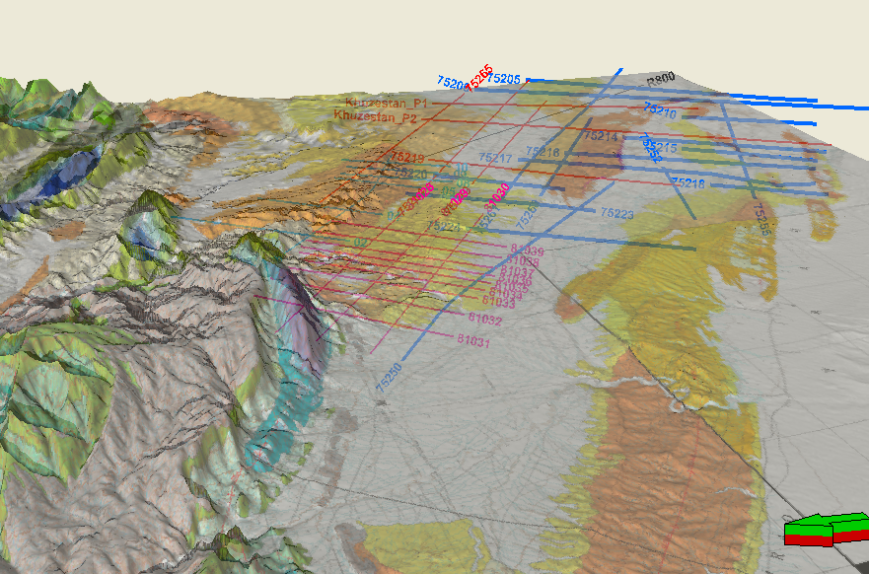
Geology
Structural Geology
Structural analysis and seismic data interpretation
2D and 3D structural restoration
Fault systems and structural models analysis

Slide 9
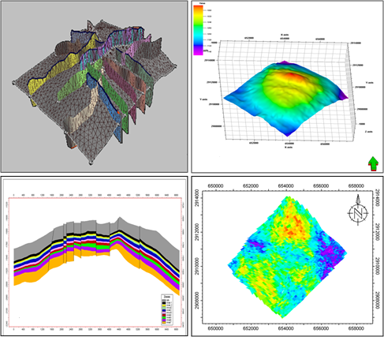
Geology
Static Reservoir Modeling
Reservoir structural modeling
Petrophysical modeling of reservoir properties
Stochastic and deterministic facies modeling
Water saturation modeling
Fracture studies
Field development and proposing new wells
Volume calculation and uncertainty analysis

Slide 10
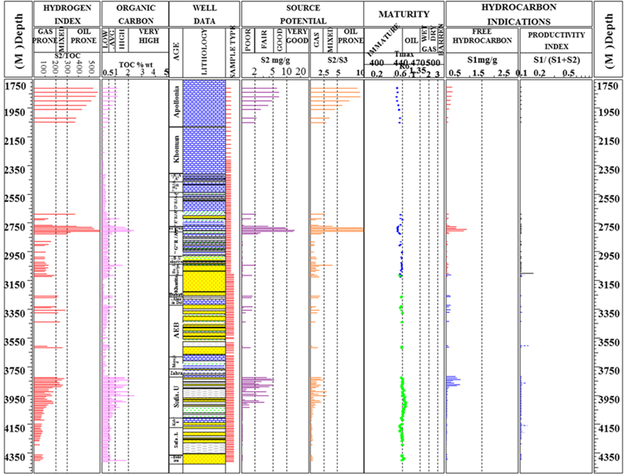
Geology
Organic Geochemistry Studies
Exploration geochemistry
Source rocks evaluation
Rock-Eval pyrolysis
Organic petrography
preparing geochemical logs and maps
Petroleum geochemistry and determination of oil families
Oil-source correlation
Gas geochemistry
Reservoir Geochemistry
Lateral and vertical reservoir partitioning
Reservoir wettability
Reservoir microbial degradation
Asphalthene precipitation analysis
Petroleum system modeling and analysis

Slide 11
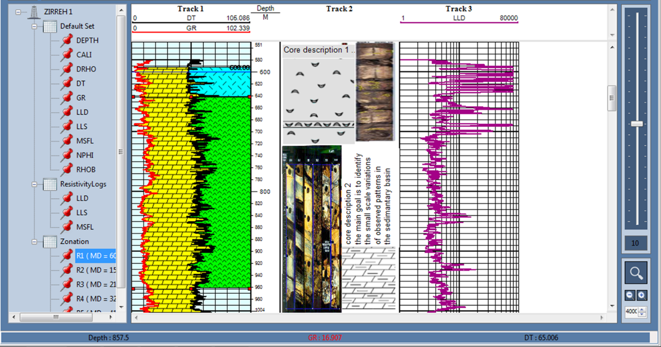
Petrophysics
Petrophysical logs interpretation and evaluation
Logging operation supervision
Perforation operation supervision

Slide 12
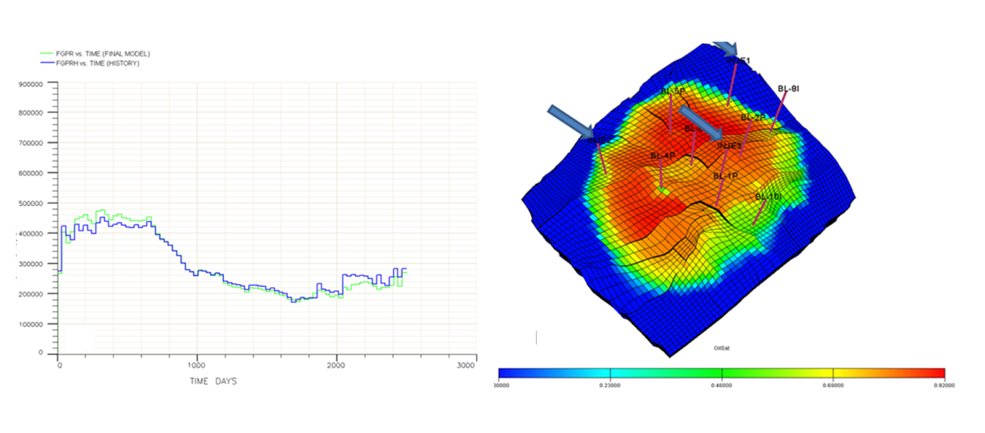
Reservoir
Basic reservoir studies and dynamic simulation
Well tests analysis
Rock typing
Production logs analysis
Core analysis, CCAL, SCAL
Dynamic simulation
History matching

Slide 13
Drilling
Drillstring Mechanics and Casing Design
Cuttings Transport
Wellbore Stress, Stability, and Strengthening
Pore pressure generation mechanisms
Drilling Fluids Management
Drilling hydraulics optimization and detailed technical analysis
Rate of penetration objective function
Optimization Concepts and Methods Relating Time, Cost, and Value

Slide 14
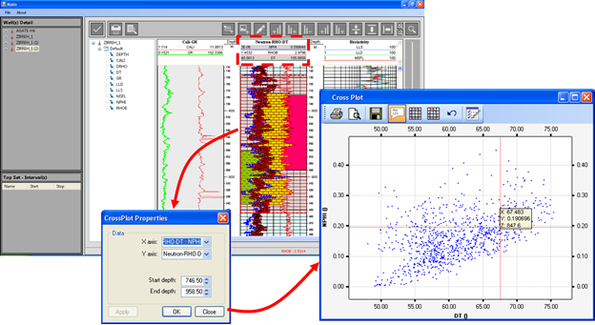
Software
Professional software training courses
Well logs visualization and interpretation software(in-house package):
This package is developed by software group of company with the aim of petrophysical evaluations. This package provides several facilities for core analysis and description, rock physics analysis and drawing composite well logs.

Slide 15
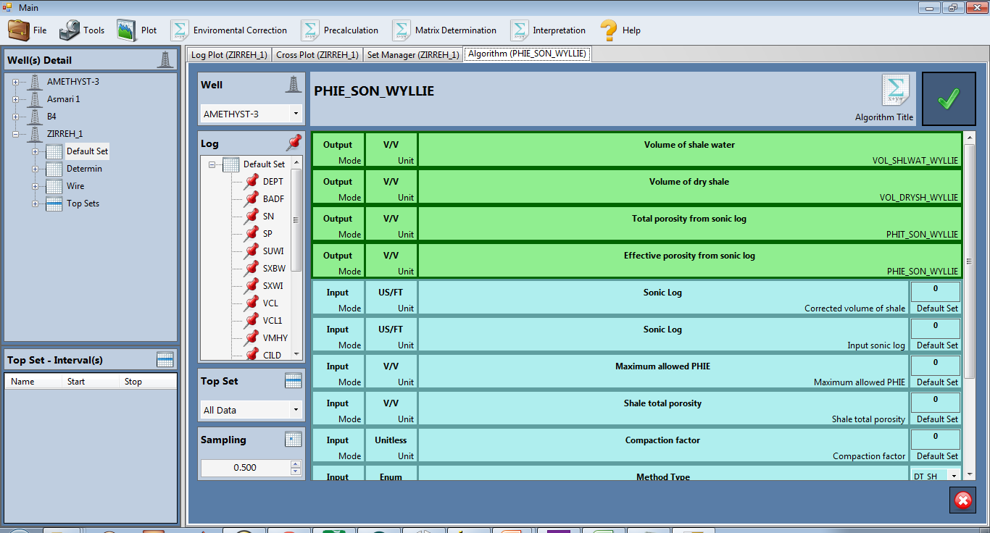
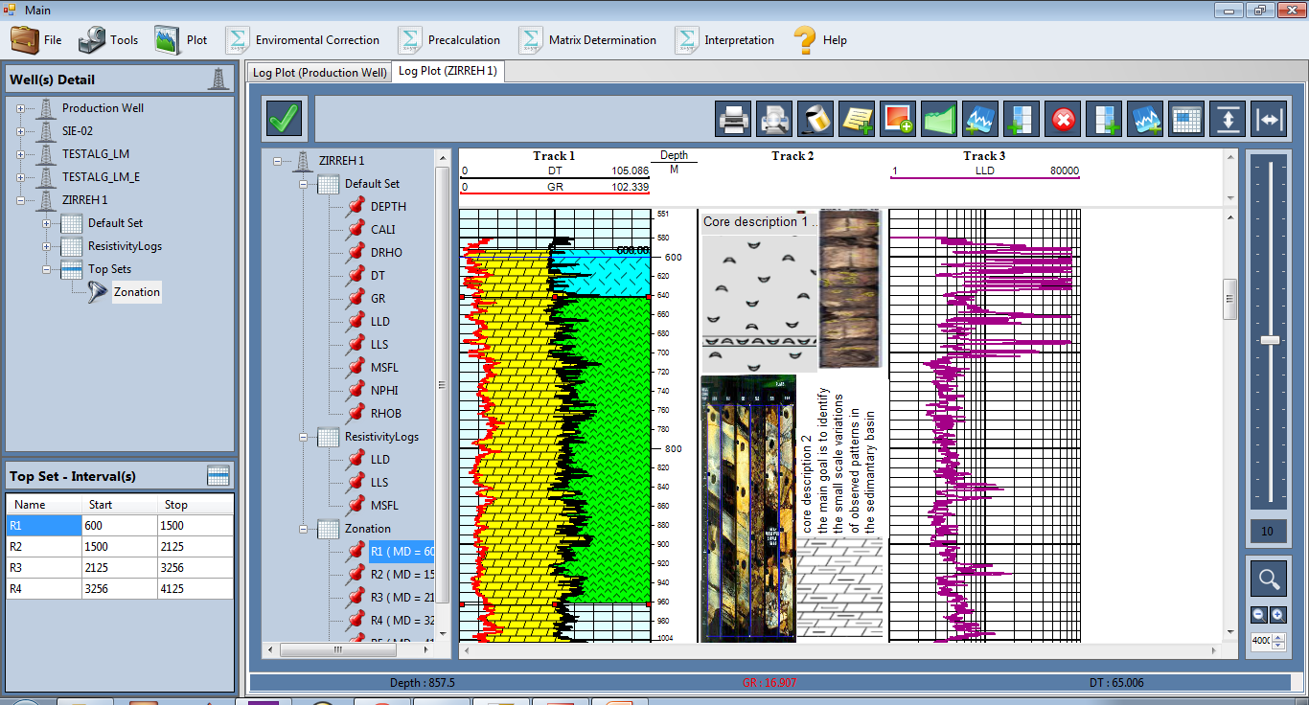
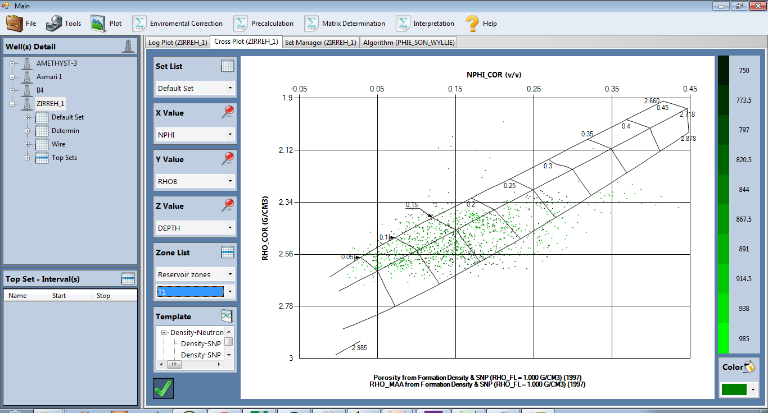
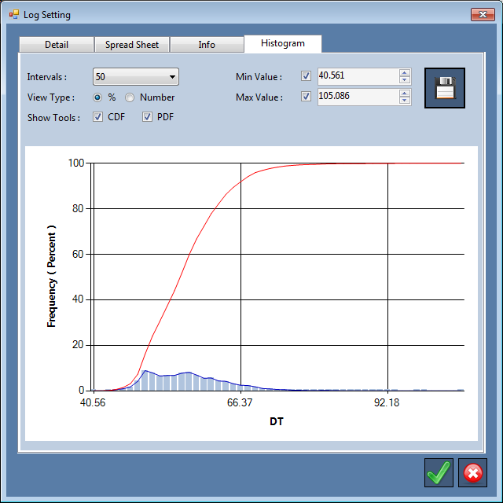
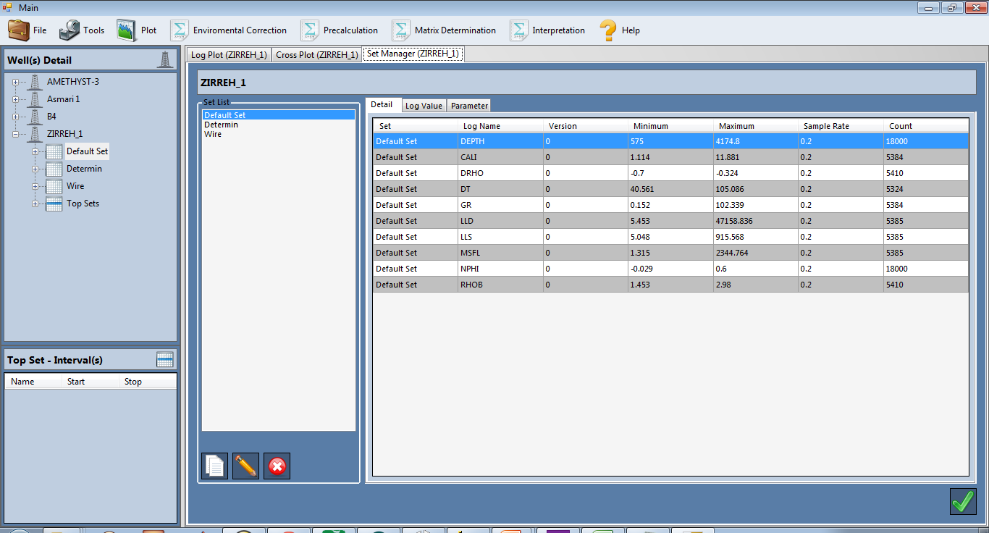
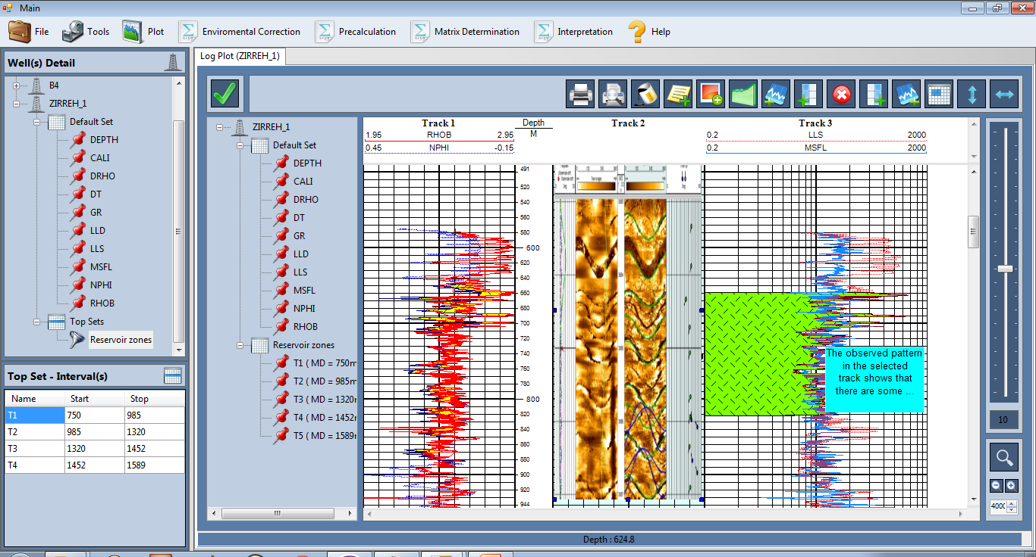
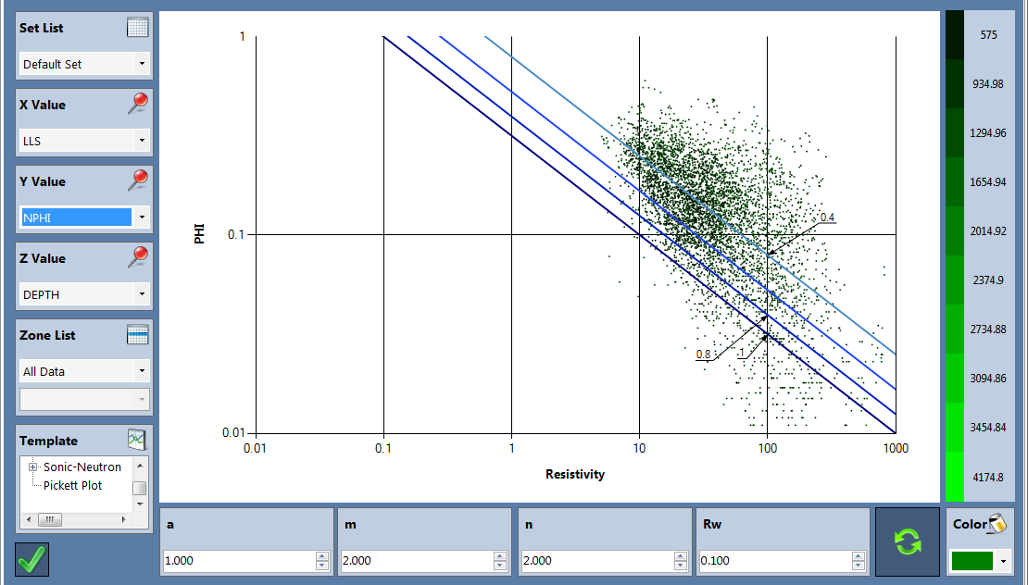
Software: Log Master

Slide 16
Skills and Software Knowledge
Skills
Structural seismic interpretation
Carbonate seismic sequence stratigraphy
Rock physics and quantitative seismic analysis
Geostatistical inversion
Geostatistics (on job training workshop)
Basin modeling
Seismic processing
Seismic survey design
Seismic facies analysis
Structural geology; Theory and field trip
Geology of Dehram group: stratigraphy, Sequence Stratigraphy, paleontology and sedimentology + Field trip (Complete Package)
Software
Petrel
HRS
Jason
Opendtect
Norsar
Promax
Focus (Paradigm)
Vista
Omni

Slide 17
IPsolution
Thank You

